Slide 1
Final Group Project -AUTHENTICATION AND AUTHORIZATION
Group - 4
Karan Upneja[200520910]
Maninder Kaur[200511303]

Slide 2
OUR TEAM
Maninder Kaur
Karan Upneja
Developer
Developer
Bachelors in Information and Technology in 2019
Almost 3+ years experience as an IT Analyst at Diverse Lynx
Bachelors in Information and Technology in 2018
Almost 4 years experience as a Java developer at Capgemini

Slide 3
PROJECT SUMMARY
This Web application was created with ASP.NET and contains user data that is protected with authorization. It displays a list of contacts that have been made by registered users.
Below are the three security groups:
Registered User : can only alter or delete their own information, but they can view all the approved contacts.
Managers : can approve or reject any contact data submitted to the website. Manager role can not edit or delete any user’s data except of his own.
Administrator : can approve or reject any contacts information’s in addition admin has full authority to create, delete or modify any contact data.

Slide 4
DEMONSTRATION
Home page - ContactManager

Slide 5
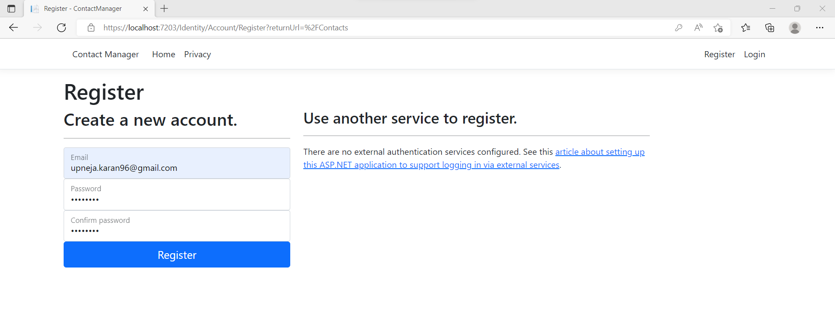
REGISTER USER
This page will allow new user to register in the application

Slide 6
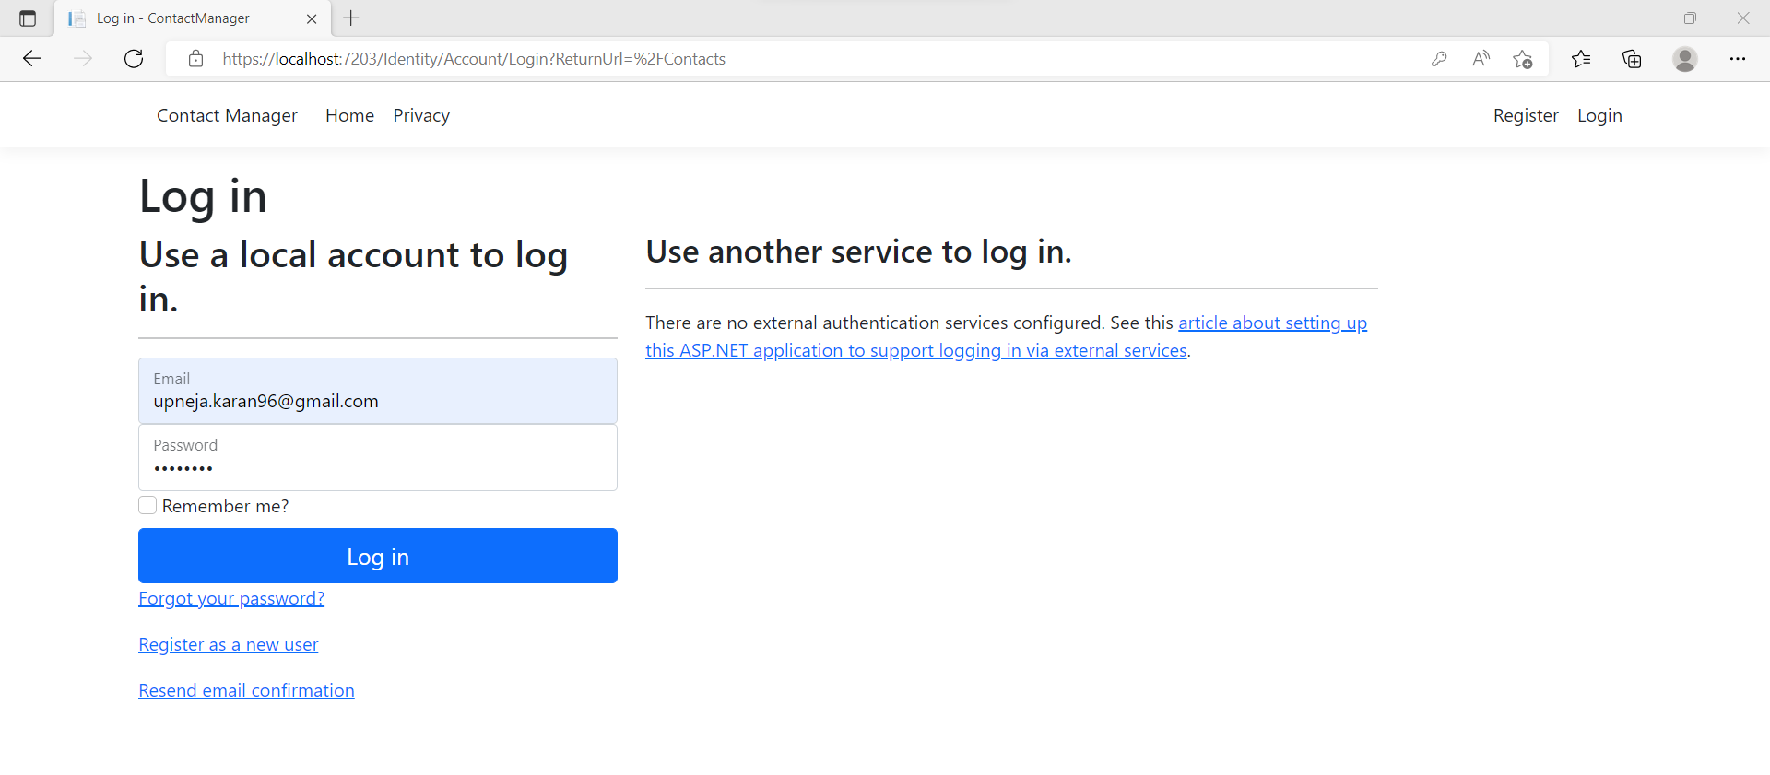
LOGIN

Slide 7
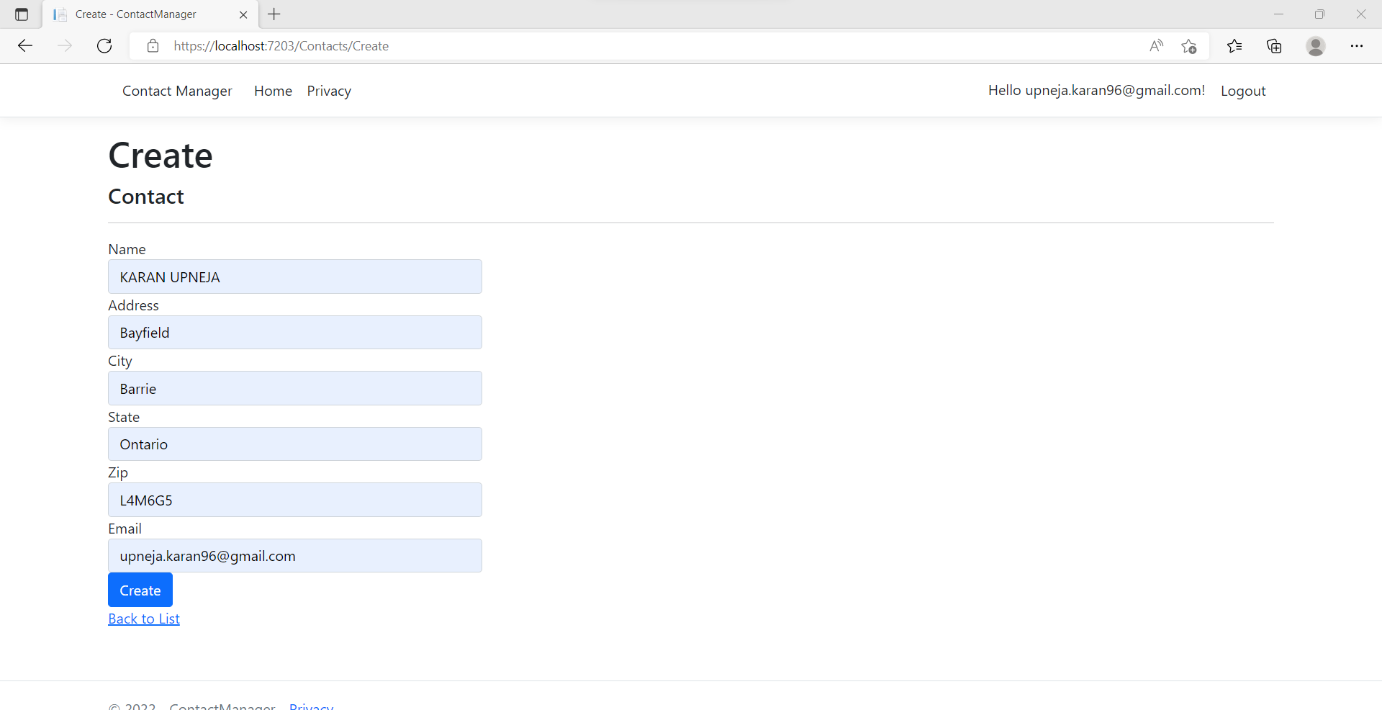
CREATE CONTACT

Slide 8
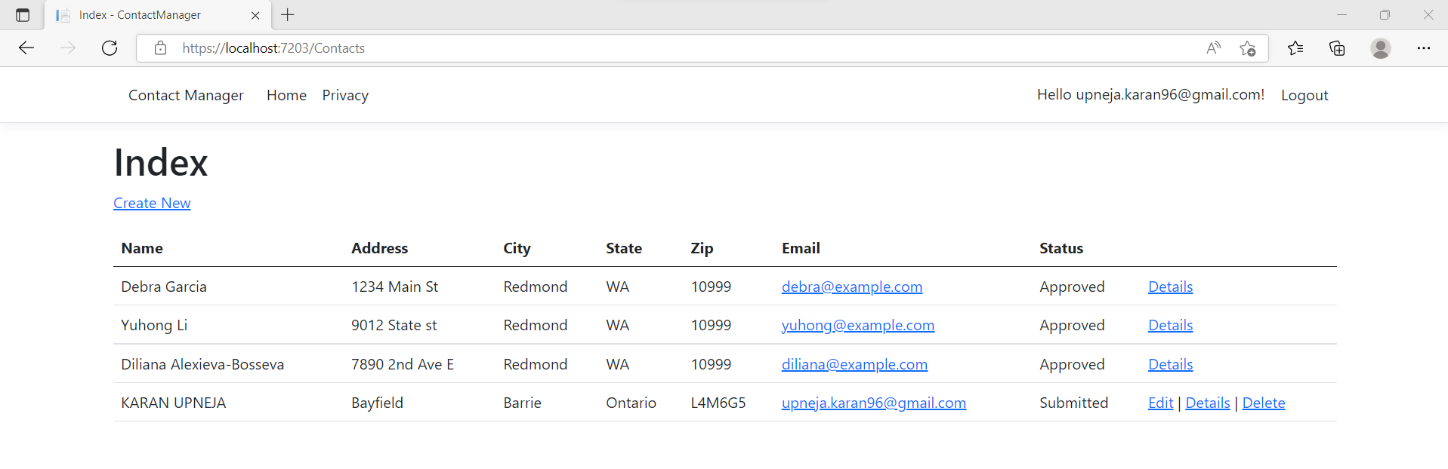
INDEX PAGE
Registered User can only see approved data. Moreover, Edit and Delete Operations are only visible for their own data

Slide 9
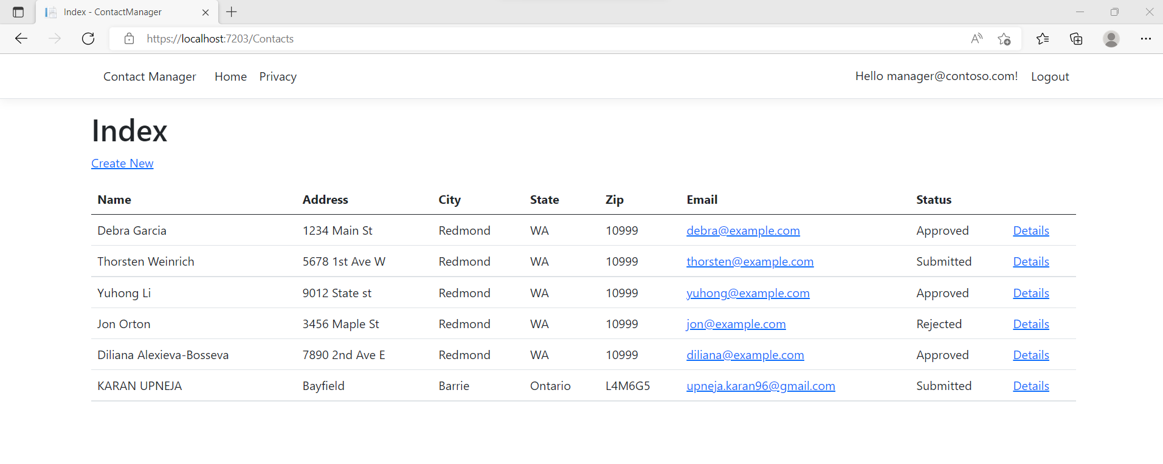
MANAGER

Slide 10
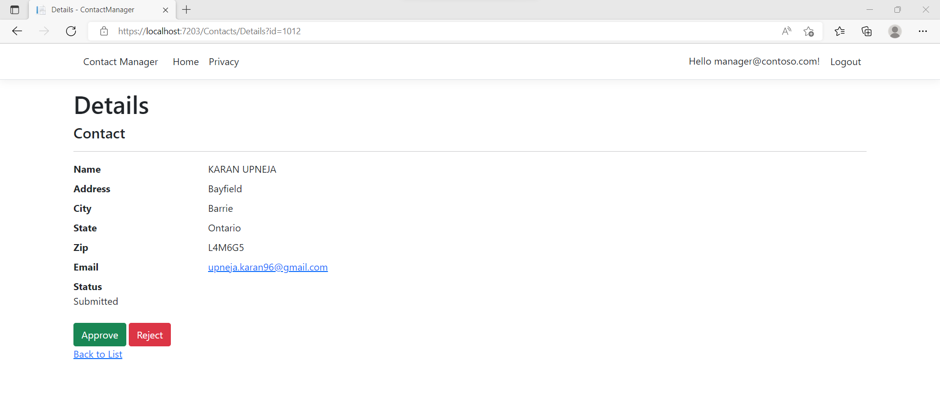
MANAGER
Manager has access to view information for each registered user. Also has authority to approve and reject any contact.

Slide 11
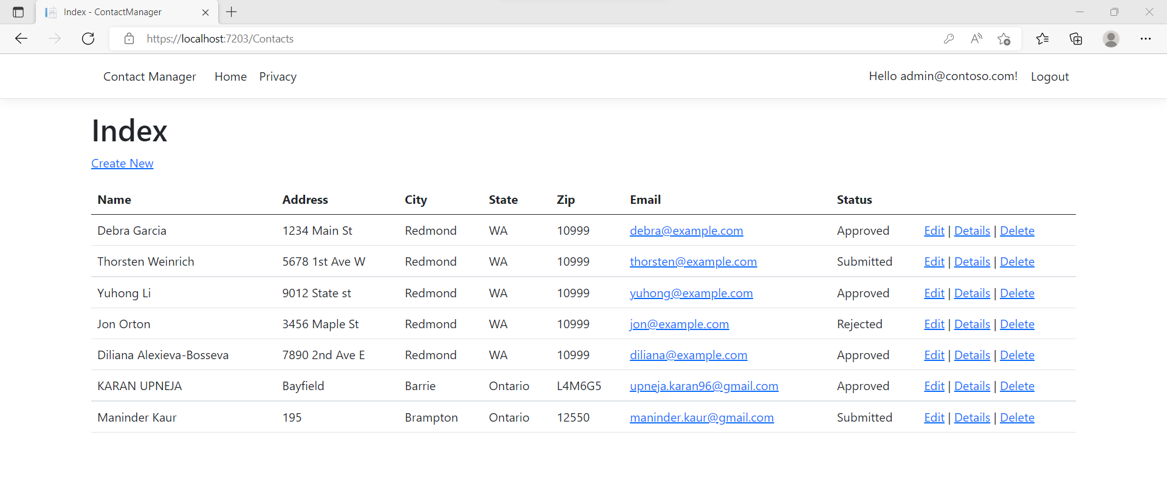
ADMINSTRATOR
Admin has full authority to edit, view or delete details for any contacts and can approve or reject as well.

Slide 12
Part 2 – SECURITY QUETIONS

Slide 13
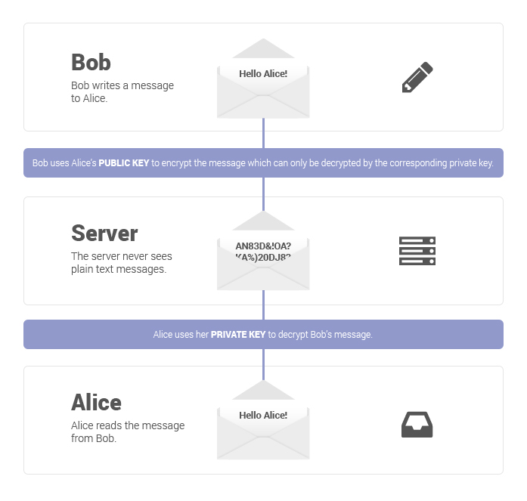
How can we transfer personal data securely within their network?
- End-to-end encryption (E2EE), where even the service provider cannot decrypt data shared over it, is the most secure solution. End-to-end encryption prevents anyone in the middle from accessing private conversations by encrypting messages at both sides of a communication.
How does E2EE works?
Benefits of E2EE
E2EE has several advantages over the standard encryption that most services use:
It keeps your data safe from hacks : You are the only person who has the private key to decrypt your data using end-to-end encryption. Hackers cannot access data on the server because they lack the private keys needed to decrypt it.
It keeps your data private: If you use Gmail, Google will have access to all private information you include in your emails and will be able to save them even after you delete them. You may choose who reads your messages with E2EE.

Slide 14
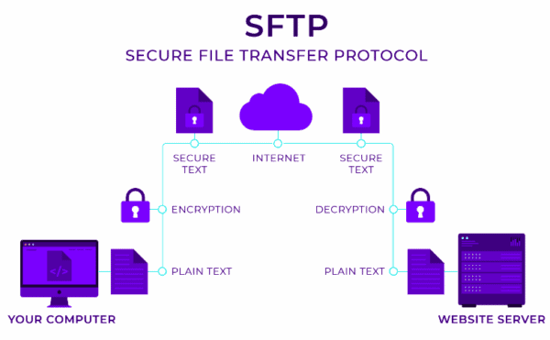
What security protocol is best for transferring personal files?
- SSH File Transfer Protocol (SFTP) is perhaps the most common and considered to be best to transfer personal files over internet.
What is SFTP?
SFTP is built on Secure Shell cryptography to encrypt data being transferred.
When compared to FTP, this encryption often results in faster transmission speeds because data is transferred in packets rather than plain text.
Moreover, it offers all of the capabilities that FTP offers, but more securely, more consistently, and with simpler configuration.
SFTP is suitable for transmitting sensitive data, such as personal information, because it permits the usage of key pairs in addition to host-based authentication.
How does SFTP works?

Slide 15
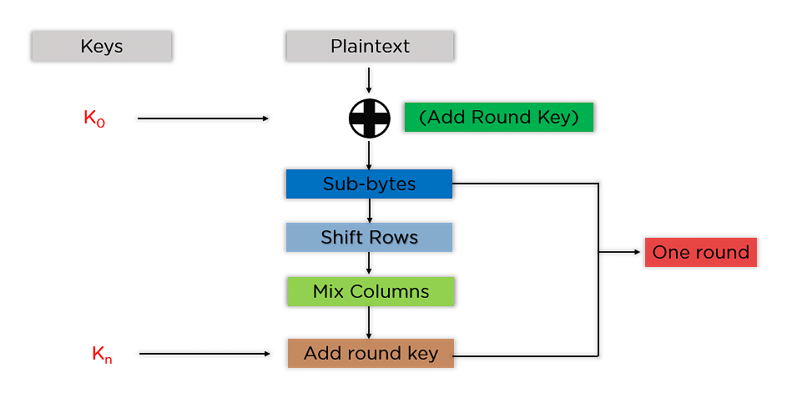
Can we encode and encrypt images?
- Images file can be encodes used Base-64 algorithm, and therefore, encrypted using AES encryption algorithm.
Base 64 algorithm
Base64 is an encoding process that transforms any text, binary data, and even images or sound files into a readable string that can be saved or sent over the network without compromising the integrity of the data.
Latin letters, numerals, plus signs, and slashes are among the characters produced by Base64 encoding.
AES encryption Algorithm
It uses a symmetric block cypher technique with 128-bit blocks or chunks. These distinct blocks are converted using keys that are 128, 192, and 256 bits long. It then connects these blocks to create the ciphertext after encrypting each one separately.

Slide 16
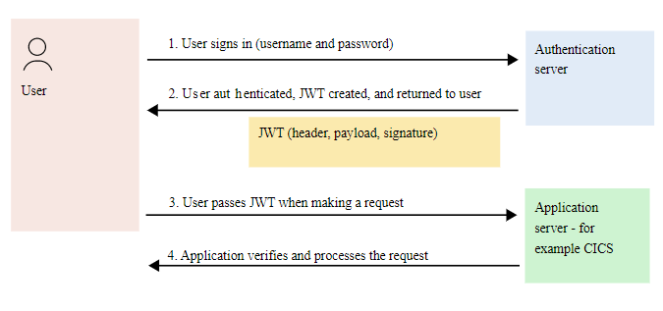
Our database cannot be moved from the site, and we need to be able to access it externally using a secure API. Can you explain the architecture of a secure API?
- JSON Web Token (JWT) can be used to securely access database.
Anatomy of a JWT
Header: Specifies the algorithm used.
Payload: contain the claim
Signature: used to verify the issuer of the JWT that is check the authenticity of the user.
JWT Authentication flow

Slide 17
Can you recommend a secure framework for coding an API?
- One of the best practice to secure an API is to Encrypt the traffic using Transport Layer Security protocol
What is TLS?
TLS is a cryptographic protocol that offers end-to-end security of data transferred between apps over the Internet.
Encrypting the exchange of data between web apps and servers is one of TLS's main applications.
TLS encryption helps shield web applications from hacking attempts and other threats.
TLS employs hash functions and secret-key cryptography to ensure data integrity and privacy while enabling authentication via public-key cryptography.
What does TLS do?
The TLS protocol achieves these three objectives primarily:
Encryption: conceals the data being transferred from outside sources.
Authentication: checks to make sure the parties sending information are who they say they are.
Integrity: checks to make sure the data hasn't been manipulated or fabricated.

Slide 18
What data interchange format should we use while transferring data between locations?
There are variety of data interchange format available When transmitting data between web servers, browsers, and mobile applications such as XML, CSV or JSON however, JSON is the standard, widely used format.
What is JSON?
JSON stands for JavaScript Object Notation
Due to its versatility and straightforward architecture, it is typically simple to operate in the programming language of your choice.
JSON is text-based and therefore is also simple to read and understand.
JSON is primarily composed of two components: keys and values. They combine to form a key/value pair.
{Key : Value} ➔ {“id” : 1}, where id is the key and 1 Is its value
Why JSON?
JSON is comparatively lighter than XML
Easy to Read and Write.
JSON is supported by almost all the browsers.
Due to it’s flexibility and light weight in nature, JSON is faster.

Slide 19
How should we store our data in our many locations?
Desktop Storage
Digital files or information can be kept locally on a computer, a laptop, or even a cell phone. Only when the devices are present can one access data stored in this local storage.
Cold Storage
This covers distinct storage devices like SD cards and flash and thumb drives. Cold storage is a backup and archiving layer that offers very affordable long-term data archival.
Cloud Storage
Data is sent over the network and stored on remote storage systems, where it is managed, backed up, and made accessible to users over a network. One can access the data stored on cloud from anywhere
Hybrid Cloud Storage
Cloud storage that is managed using both on-site and off-site resources is known as hybrid cloud storage. By combining internal data storage with public cloud storage, the hybrid cloud storage infrastructure is frequently employed.

Slide 20
What are the ethical concerns related to the transmission of personal data?
Confidentiality
A person who is not authorized to see the information cannot ever receive access to personal data
Integrity
Information must not be altered while being stored or transported. Any change must be discernible.
Non-Repudiation
The person who created or sent the information cannot afterwards deny that they had any involvement in its development or transmission.
Authentication
Identify and authorize the sender as well as recipient before any information is sent or received.

Slide 21
REFERENCES
https://proton.me/blog/what-is-end-to-end-encryption
https://www.cloudflare.com/learning/ssl/transport-layer-security-tls/
https://www.ssh.com/academy/ssh/sftp
https://www.simplilearn.com/tutorials/cryptography-tutorial/aes-encryption
https://www.ibm.com/docs/en/cics-ts/6.1?topic=cics-json-web-token-jwt
Lecture Notes

